Slide 1
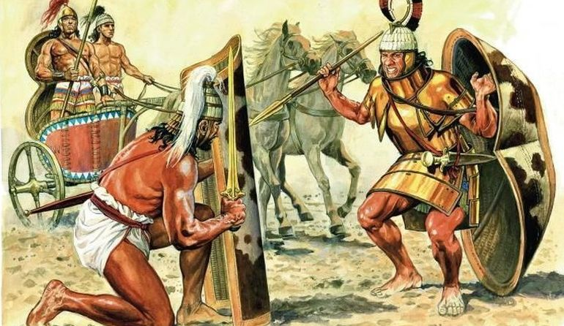
The Myceneans
Goal/s:
Review the Mycenaean civilization – book out, no title/goals!
Week 8 Lesson 4
Ms Barrie

Slide 2
Instructions – Study Sheet
Create an A3 Study Poster about the Mycenaeans
Must include:
Overview (timeline/context)
People, Events, Ideas (inc. Homer and Trojan War)
Structures (Social, Political, Economic, Religious, Military)
Archaeological Evidence (Schliemann, Gate, Masks)

